Slide 1
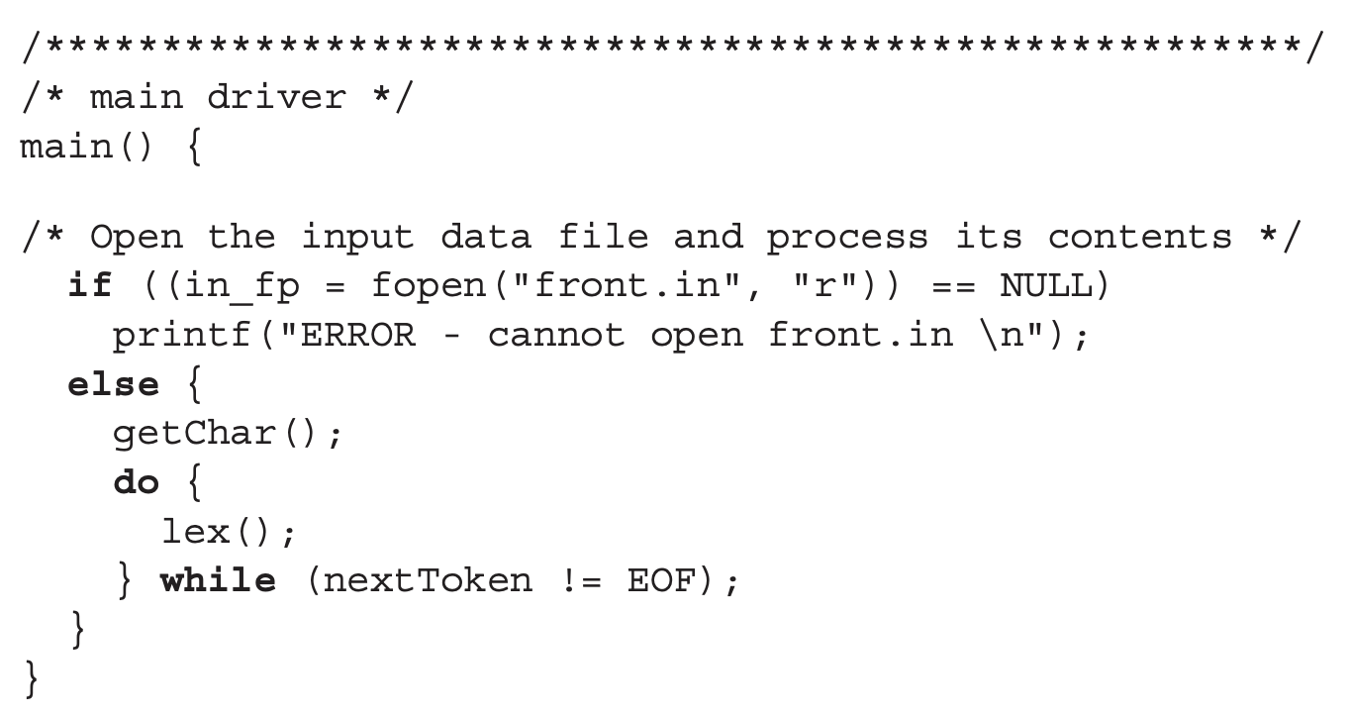
Lexical Analysis
Example
front.in
(sum + 47) / total
main(int argc, char** argv)

Slide 2
Lexical Analysis
LETTER
UNKHOWN
charClass =
lexeme[100] =
nextChar =
lexLen =
token =
nextToken =
“(”
“(\0”
Example
‘(‘
front.in
‘s’
1
0
(sum + 47) / total
LEFT_PAREN
getChar()
- nextChar = ‘(’
- isalpha(nextChar) // F
- isdigit(nextChar) // F
- charClass = UNKNOWN
lookup(char ch)
- switch(ch) // ‘(’
- addChar()
- nextToken = LEFT_PAREN
addChar()
- lexeme[lexLen++] = nextChar
- lexeme[lexLen] = 0 // NULL
lex()
- lexLen = 0
- getNonBlank()
- switch(charClass) // UNKNOWN
- lookup(nextChar)
- getChar()
- printf(nextToken, lexeme)
getChar()
- nextChar = ‘s’
- isalpha(nextChar) // T
- charClass = LETTER

Slide 3
Lexical Analysis
LETTER
charClass =
lexeme[100] =
nextChar =
lexLen =
token =
nextToken =
“s\0”
“sum\0”
“su\0”
Example
‘u’
‘m’
front.in
‘s’
1
0
(sum + 47) / total
LEFT_PAREN
lex()
- lexLen = 0
- getNonBlank()
- switch(charClass) // LETTER
- addChar()
- getChar()
- while (charClass == LETTER ||
charClass == DIGIT)
- addChar()
- getChar()
- printf(nextToken, lexeme)
addChar()
- lexeme[lexLen++] = nextChar
- lexeme[lexLen] = 0; // NULL
addChar()
- lexeme[lexLen++] = nextChar
- lexeme[lexLen] = 0; // NULL
getChar()
- nextChar = ‘u’
- isalpha(nextChar) // T
- charClass = LETTER
getChar()
- nextChar = ‘ ’
- isalpha(nextChar) // F
- isdigit(nextChar) // F
- charClass = UNKNOWN
getNonBlank()
- isspace(nextChar)
- getChar()
getChar()
- nextChar = ‘+’
- isalpha(nextChar) // F
- isdigit(nextChar) // F
- charClass = UNKNOWN

